Slide 1

AI BASED CONTENT MODERATION FOR CHATBOTS AND CONVERSATIONAL PLATFORM
MEET OUR TEAM
1. PALANIAPPAN M
2. RISHI RAJ G
3. SUDHARSAN D
4. SURUTHY R
5. SWETHA VARNAA U
YEAR: III
DEPARTMENT: IT
COLLEGE: REC
SPOC PH NO: 8681913204

Slide 2

Introduction
01
Business Need / Opportunity
It’s 2020 and we’re uploading and
consuming content faster than ever
before. As the amount of users continues to accelerate ,it has become impossible to identify and remove harmful content using traditional human-led moderation approaches
This project examines capabilities of artificial intelligence(AI) technologies in meeting the challenges of moderating online content.

Slide 3
02
Human Moderators to AI
Many of us are not aware that all these
contents are moderated by actual human
beings. Human moderators are the one’s who
filter these contents out to maintain safe
environment and ensure smooth user
experience
Despite establishing clear guidelines, human
moderators can still be prone to errors as they
are expected to work fast in order to handle
the high Volume
An important thing to add is that the job is
very disturbing and can cause trauma in the
individuals doing it day in and out.

Slide 4
03
Target Segment / Market Size
Content sharing platforms like Medium, Reddit, Quora, Discord etc.
Social media applications like Twitter,etc.
Group communication platforms like Google meet, Zoom , Skype etc.
Companies can utilise according to their requirements.

Slide 5

04
Solution / Idea in a nutshell
To use ARTIFICIAL INTELLIGENCE for classification and removal of harmful content that helps online sites and social media platforms.
AI Moderator is a fully automated moderation tool that protects from abusive user-generated content.
There are multiple API’s available online that can be integrated with our AI model as-a-service to moderate content on a users platform. We sell our AI model to companies or offer it as a service.

Slide 6

05
Business Impact /Measure of Success
Operating globally and setting standards for content is very tricky
We can able to detect the sensitive content., etc through all of the Discussion Forums.
Examples:
Cruel and insensitive
Nudity, obscenity
Religious hate speech inciting violence
Fake news and spreading for a political agenda
Defamatory language against an individual/organisation

Slide 7
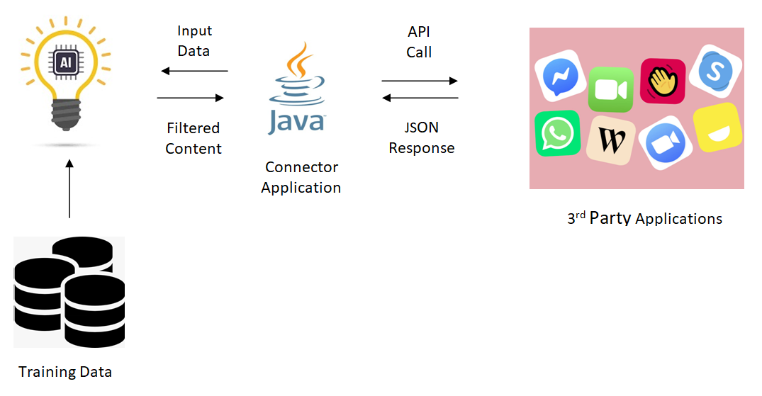


Technology Stack

Slide 8
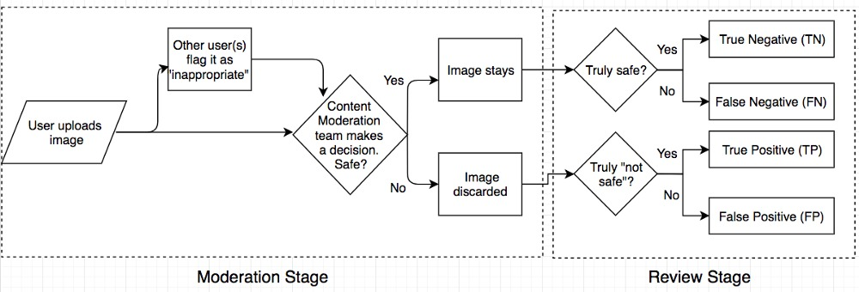
Flow Chart
Classification

Slide 9
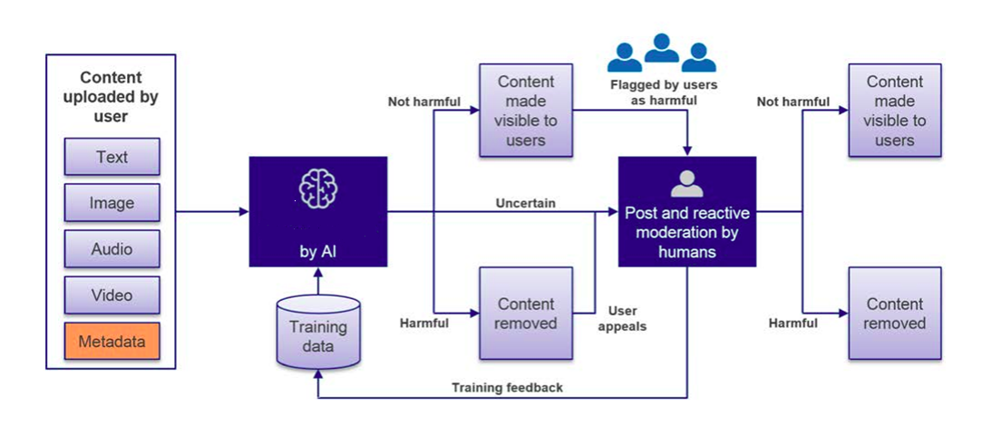
ARCHITECTURE DIAGRAM

Slide 10

Artificial
Intelligence
Thank You

